Slide 1




ASCEND! Team
Spring 2017
Presented by
Nicholas Mallott, mallottn@erau.edu
Embry-Riddle Aeronautical University, Prescott
ASCEND! Team Lead

Slide 2
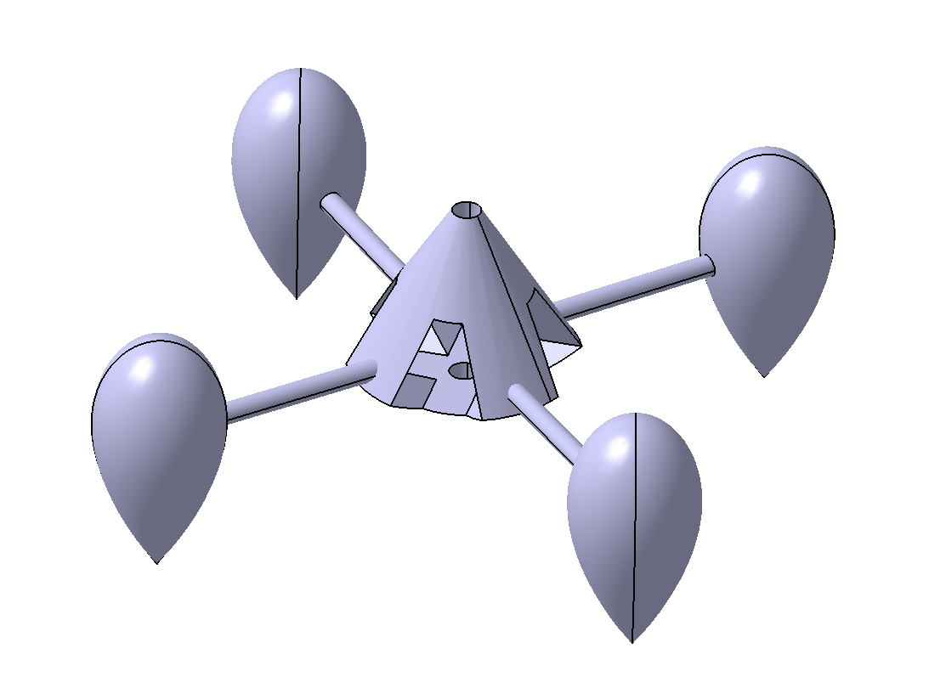
Team Members
Nicholas Mallott – Aerospace Engineering Student
  Team Lead, Structural Design and Integration
Xander Pickard – Mechanical Engineering Student
  Fabrication and Lead Technologist
Jack Crabtree - Mentor

Slide 3
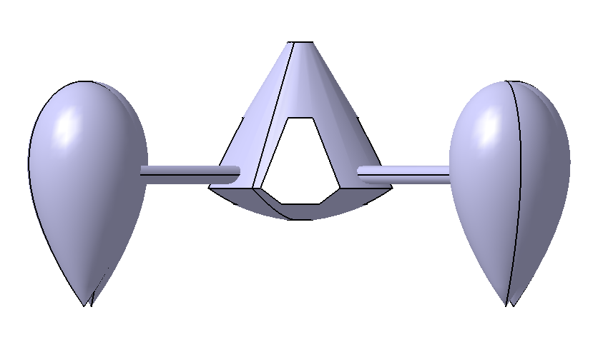
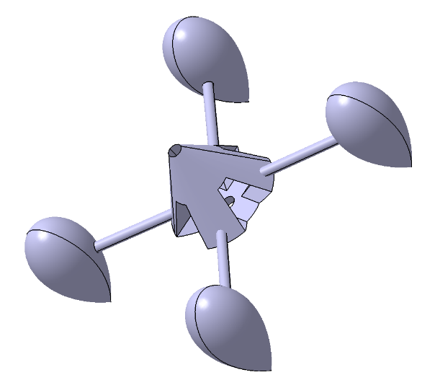
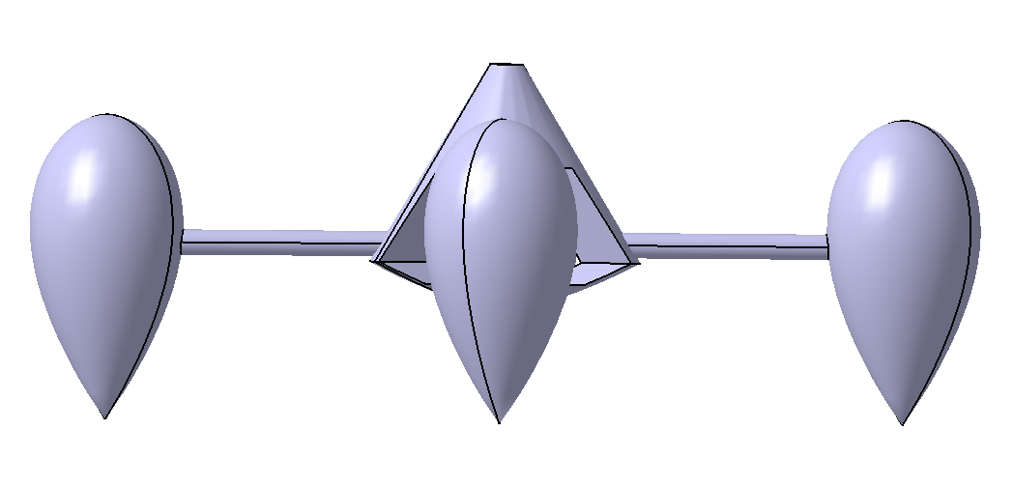
Problem Statement
Balloon controllability
Axial spin / tilt in flight
Rates of acceleration
Rates of spin

Slide 4
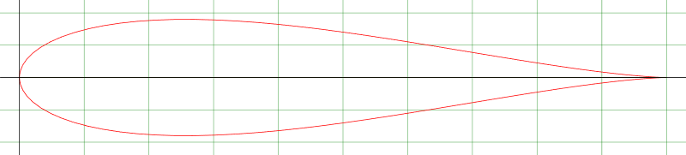
Objectives
Develop a passive control system
Design a system to reduce axial rotation rates
Prevent tilt of system about secondary axes
Reduce acceleration spikes
Build a system to accomplish this using aerodynamic principles

Slide 5
General Principles
Airfoil Designs
  Joukovsky 18% Symmetrical Airfoil
  Joukovsky 15% Symmetrical Airfoil
  Eppler 479 Aerobatic Airfoil
Mass-moment of inertia
Flutter vs Airfoil Design
  Function of Structure, Inertia and Applied Aerodynamic Forces

Slide 6
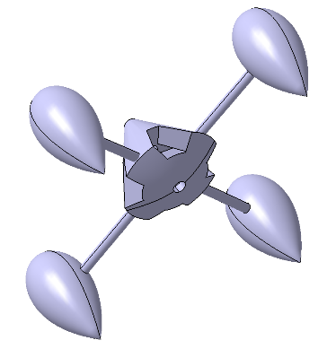
Payload Design
ABS (acrylonitrile butadiene styrene) plastic main chassis for sensors / base
  Stronger, flexible and accuracy
PLA (polylactic acid) for outrigger system
  Lighter, higher rigidity and softer rounding edges
Zinc rods for connectors
Fiberglass center rod

Slide 7
Results (Fall Launch)

Slide 8
Results (Spring Launch)

Slide 9
Comparative Analysis

Slide 10
Conclusions

Slide 11

Acknowledgements
The Arizona Space Grant Consortium for the support, vision and opportunity to enable this project to carry on
Arizona Near-Space Research for their support of and for the ASCEND! Project, and for their dedication to science and exploration
Embry-Riddle Aeronautical University for their pursuit of excellence, in and out of the classroom
Prof. Jack Crabtree for his continued support, guidance and supervision of this project

Slide 12

Questions?
Thank you for your support and your time.

Slide 13
Images taken from:
https://theta360.com/en/about/theta/s.html
http://www.ansr.org/
https://www.nasa.gov/
http://spacegrant.pr.erau.edu/
https://spacegrant.arizona.edu/
http://www.airfoiltools.com/airfoil/details?airfoil=e479-il
http://www.airfoiltools.com/airfoil/details?airfoil=joukowsk0015-jf
http://www.airfoiltools.com/airfoil/details?airfoil=joukowsk0018-jf
Template from ASCEND! Team Lead Joseph Mena: Fall 2015 – Spring 2016

Slide 14
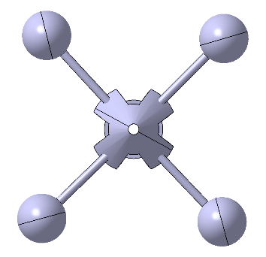

Extra Pics

Slide 15
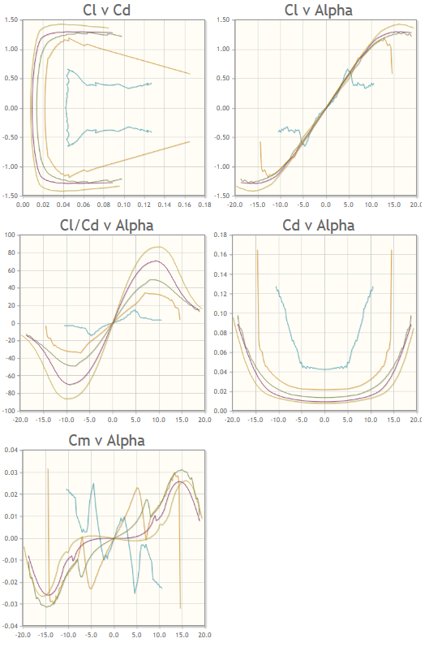
Principles
Expanded
(J – 18%)

Slide 16
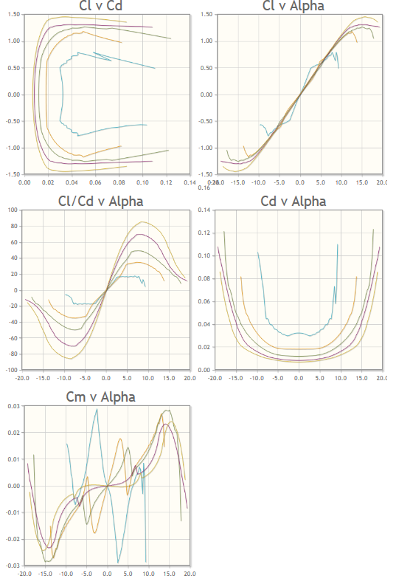
Principles
Expanded
(J – 15%)

Slide 17
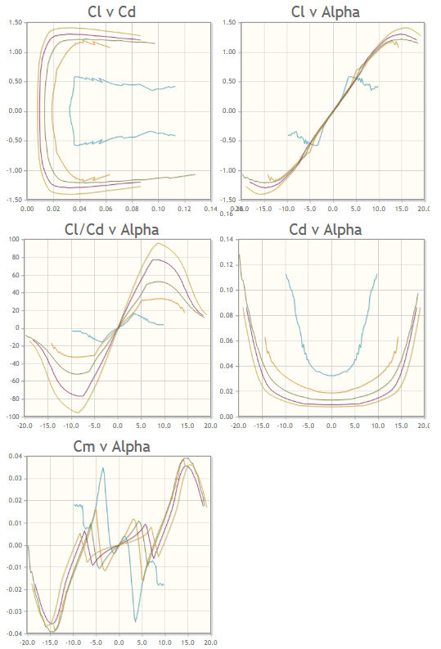
Principles
Expanded
(Eppler)

Slide 18
The Payload
Testing controls systems as they pertain to balloon missions
Implementing passive design via aerodynamic stabilization in tandem with mass moment of inertia manipulation
Interested in:
  Stabilization effects for recording
  IMU (inertial measurement unit) data

Slide 19
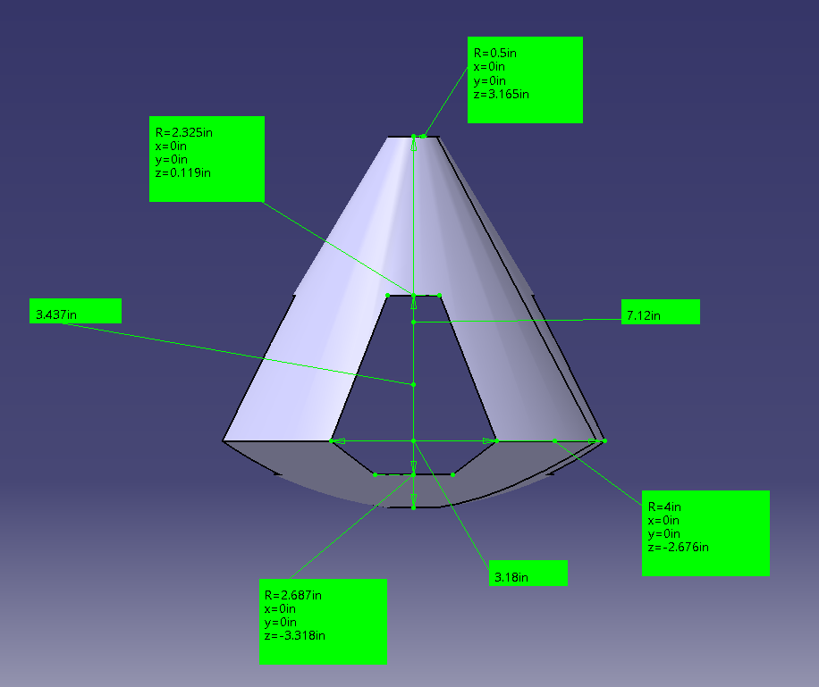
Payload Design (Dimensioning)

Slide 20
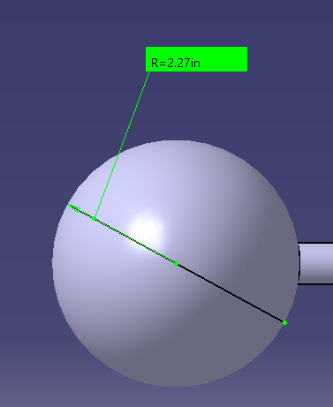
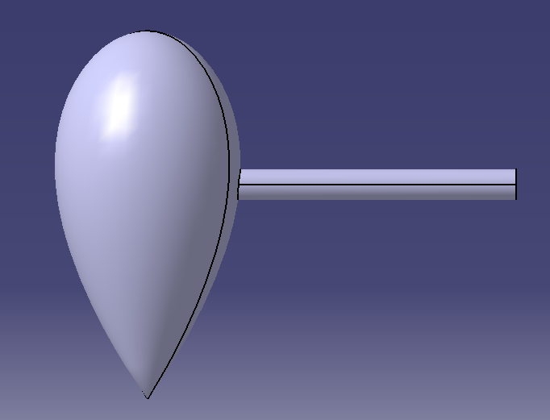
Payload Design (Dimensioning)

Slide 21

Payload Design
Ricoh Theta S
  360 Camera and Video support
  W/o external battery, picture every
  30 seconds for entire flight
  W/ external power, pictures every 10
  seconds with fully charged batteries
  Video capability only up to 25 minutes /
  4 GB until stop time
https://theta360.com/en/about/theta/s.html

Slide 22
Final Payload – 2.942 lbs
ABS Main Chassis
4x PLA Outriggers
4x Zinc Threaded Rods
Ricoh Theta S – 360 Camera
Razor IMU – Accelerometer/ Gyroscope Readings
Carbon-Composite Bolting Board
Fiberglass Core Securing Rod
External Batteries

